Slide 1


Slide 2


Slide 3

Please read this disclaimer before proceeding:
This document is confidential and intended solely for the educational purpose of RMK Group of Educational Institutions. If you have received this document through email in error, please notify the system manager. This document contains proprietary information and is intended only to the respective group / learning community as intended. If you are not the addressee you should not disseminate, distribute or copy through e-mail. Please notify the sender immediately by e-mail if you have received this document by mistake and delete this document from your system. If you are not the intended recipient you are notified that disclosing, copying, distributing or taking any action in reliance on the contents of this information is strictly prohibited.

Slide 4
22CS701- CRYPTOGRAPHY AND CYBER SECURITY
(Lab Integrated)
Unit-III
Department: Computer Science and Engineering
Batch/Year : 2023-2027/IV
Created by:
Dr.M.P.Karthikeyan,Associate Professor/CSE/RMKEC
Ms.Kanimozhi.S Assistant Professor/CSE/RMKEC
Dr. K.Mohanasundaram, Associate Professor/CSE/RMDEC Dr.J.Sherine Glory ,Associate Professor/CSE/RMDEC Dr.R.Aruna,Associate Professor/CSE/RMDEC Dr.N.P.Ponnuviji,Associate Professor/CSE/RMKCET Dr.R.Prasath , Professor/CSE/RMKCET
Dr.G.Indra, Associate Professor/CSE/RMKCET
Mr.Vinoth Kumar V, Assistant Professor/CSE(CS)/RMKCET
Date: 06.05.2026

Slide 5
Table of Contents
S.NO | CONTENTS | PG NO
1 | Contents | 5
2 | College Vision & Mission | 6
3 | Department Vision & Mission | 7
4 | Course Objectives | 8
5 | Pre-Requisites (Course Name with Code) | 8
6 | Syllabus (With Subject Code, Name, LTPC Details Total hours , Text book and reference books details ) | 9
7 | Course Outcomes ( Maximum 6) | 11
8 | CO-PO/PSO Mapping | 12
9 | Lecture Plan | 13
10 | Pedagogy / Teaching –Learning Methods | 14
11 | Case Study based Teaching, Activity Based Learning | 15,16
12 | Lecture Notes | 18
13 | Assignments, AI Based Examples | 44, 46
14 | Part A Questions & Answers (with K Level and CO) | 48
15 | Part B Questions (with K Level and CO) | 54
16 | GATE Questions, Supportive Online Certification Courses (NPTEL, SWAYAM, Coursera, Udemy, etc.) | 56, 58
17 | Real-Time Applications in Day-to-Day Life and Industry | 59
18 | Complex engineering problem | 60
19 | SDG activities for the course | 61
20 | Contents Beyond the Syllabus (CO-related Value-Added Courses) | 62
21 | Assessment Schedule (Proposed Date & Actual Date) | 63
22 | Seminar topics | 64
23 | Mini / Micro Project list | 65
24 | Prescribed Textbooks & Reference Books | 67

Slide 6
COLLEGE VISION & MISSION
Vision
To be a globally recognized institution of technical excellence that nurtures knowledge, fosters innovation, and promotes research aligned with the Sustainable Development Goals, transforming students into ethical engineers and visionary leaders for societal development.
Mission
To provide quality technical education that builds strong fundamentals, practical skills, and lifelong learning abilities in students.
To promote innovation, entrepreneurship, and research through a creative academic environment and industry collaboration.
To develop ethically responsible engineers who contribute to sustainable development and societal well-being.
To encourage interdisciplinary learning and problem-solving that addresses real-world challenges in line with the Sustainable Development Goals.
To nurture leadership, teamwork, and professional excellence so that students emerge as competent engineers and visionary leaders

Slide 7
DEPARTMENT VISION AND MISSION
VISION
To produce intellectual and globally competent software professionals through excellence in education, innovation, and research, providing sustainable solution for societal development
MISSION
To impart modern teaching methodologies to provide quality technical education in Computer Science and Engineering.
To establish a conducive learning environment to practice emerging software tools and programming languages.
To identify industry requirements and develop employable software engineers.
To engage students and faculty in research and innovation to address the evolving needs of the software industry and societal development.

Slide 8
22CS701-CRYPTOGRAPHY AND CYBER SECURITY
(Lab Integrated)
COURSE OBJECTIVES
The Course will enable learners to:
● Understand the fundamentals of network security and security architecture.
● Learn the different symmetric key cryptographic algorithms.
● Study the various asymmetric key cryptographic algorithms and techniques.
● Know the importance of message authentication and integrity.
● Learn the various cyber-crimes and cyber security
PREREQUISITE
22MA201 Transforms and Numerical Methods
22CS501 Computer Networks

Slide 9
22CS701 CRYPTOGRAPHY AND CYBER SECURITY
(Lab Integrated)
SYLLABUS
3 0 2 4
UNIT I INTRODUCTION TO SECURITY 9+6
Computer Security Concepts – The OSI Security Architecture – Security Attacks – Security Services and Mechanisms – A Model for Network Security – Classical encryption techniques: Substitution techniques, Transposition techniques, Steganography –Foundations of modern cryptography: Perfect security – Information Theory – Product Cryptosystem – Cryptanalysis.
List of Exercise/Experiments:
1. Perform encryption, decryption using the following substitution techniques
(i) Ceaser cipher, (ii) playfair cipher iii) Hill Cipher iv) Vigenere cipher
2. Perform encryption and decryption using following transposition techniques
Rail fence ii) row & Column Transformation
UNIT II SYMMETRIC CIPHERS 9+6
Number theory – Algebraic Structures – Modular Arithmetic - Euclid‘s algorithm –
Congruence and matrices – Group, Rings, Fields, Finite Fields SYMMETRIC KEY CIPHERS: SDES – Block Ciphers – DES, Strength of DES – Differential and linear cryptanalysis – Block cipher design principles – Block cipher mode of operation
– Evaluation criteria for AES – Pseudorandom Number Generators – RC4 – Key
distribution.
List of Exercise/Experiments:
1. Apply DES algorithm for practical applications.
2. Apply AES algorithm for practical applications.
UNIT III ASYMMETRIC CRYPTOGRAPHY 9+6
MATHEMATICS OF ASYMMETRIC KEY CRYPTOGRAPHY: Primes – Primality Testing –Factorization – Euler’s totient function, Fermat’s and Euler’s Theorem – Chinese Remainder Theorem – Exponentiation and logarithm ASYMMETRIC KEY CIPHERS: RSA cryptosystem – Key distribution – Key management – Diffie Hellman key exchange -– Elliptic curve arithmetic – Elliptic curve cryptography.
List of Exercise/Experiments:
1. Implement RSA Algorithm using HTML and JavaScript.
2. Implement the Diffie-Hellman Key Exchange algorithm for a given problem.
3. Calculate the message digest of a text using the SHA-1 algorithm.

Slide 10
22CS701 CRYPTOGRAPHY AND CYBER SECURITY
(Lab Integrated)
SYLLABUS
3 0 2 4
UNIT IV INTEGRITY AND AUTHENTICATION ALGORITHMS 9+6
Authentication requirement – Authentication function – MAC – Hash function – Security of hash function: HMAC, CMAC – SHA – Digital signature and authentication protocols – DSS – Schnorr Digital Signature Scheme – ElGamal cryptosystem – Entity Authentication: Biometrics, Passwords, Challenge Response protocols – Authentication applications – Kerberos MUTUAL TRUST: Key management and distribution – Symmetric key distribution using symmetric and asymmetric encryption – Distribution of public keys – X.509 Certificates
List of Exercise/Experiments:
1. Implement the SIGNATURE SCHEME - Digital Signature Standard.
2. Demonstrate intrusion detection system (ids) using any tool eg. Snort or any other s/w
UNIT V CYBER CRIMES AND CYBER SECURITY 9+6
Cyber Crime and Information Security – classifications of Cyber Crimes – Tools and
Methods – Password Cracking, Keyloggers, Spywares, SQL Injection – Network Access Control – Cloud Security – Web Security – Wireless Security
List of Exercise/Experiments:
1. Automated Attack and Penetration Tools
a. Exploring N-Stalker, a Vulnerability Assessment Tool
2. Defeating Malware
i) Building Trojans ii) Rootkit Hunter

Slide 11
COURSE OUTCOMES
CO1 | Explore cryptographical concepts
CO2 | Implement various cryptographic algorithms
CO3 | Evaluate and apply network security protocols, to secure communications over networks
CO4 | Identify common security threats and vulnerabilities and assess their impact on network security
CO5 | Implement access control mechanisms and authentication techniques to protect information systems
CO6 | Develop and propose security policies and best practices for securing networks and information systems

Slide 12
CO-PO MAPPING
COs | PO’s/PSO’s
 | PO 1 | PO 2 | PO 3 | PO 4 | PO 5 | PO 6 | PO 7 | PO 8 | PO 9 | PO 10 | PO 11 | PO 12 | PSO 1 | PSO 2 | PSO 3
CO1 | 3 | 3 | 3 | 2 | 2 | - | - | 2 | 2 | 1 | - | 2 | 2 | 2 | 1
CO2 | 3 | 3 | 3 | 2 | 2 | - | - | 2 | 2 | 1 | - | 2 | 2 | 2 | 1
CO3 | 3 | 3 | 3 | 2 | 2 | - | - | 2 | 2 | 1 | - | 2 | 2 | 2 | 1
CO4 | 3 | 3 | 3 | 2 | 2 | - | - | 2 | 2 | 1 | - | 2 | 2 | 2 | 1
CO5 | 3 | 3 | 3 | 2 | 2 | - | - | 2 | 2 | 1 | - | 2 | 2 | 2 | 1
CO6 | 3 | 3 | 3 | 2 | 2 | - | - | 2 | 2 | 1 | - | 2 | 2 | 2 | 1
1 – Low, 2 – Medium, 3 – Strong

Slide 13

LECTURE PLAN
S No | Topics | No. of periods | Pertaining CO | Taxonomy level | Mode of delivery
1 | Course objective, course outcome delivery & Course introduction | 1 | CO3 | K1 | ICT Tools
2 | Primes , Primality Testing, Factorization | 1 | CO3 | K3 | ICT Tools
3 | Euler‘s totient function, Fermat‘s and Euler‘s Theorem | 1 | CO3 | K3 | ICT Tools
4 | Chinese Remainder Theorem – Exponentiation and logarithm | 1 | CO3 | K3 | ICT Tools
5 | RSA cryptosystem | 1 | CO3 | K3 | ICT Tools
6 | Key distribution, Key management | 1 | CO3 | K2 | ICT Tools
7 | Diffie Hellman key exchange | 1 | CO3 | K3 | ICT Tools
8 | Elliptic curve arithmetic | 1 | CO3 | K3 | ICT Tools
9 | Elliptic curve cryptography | 2 | CO3 | K3 | ICT Tools

Slide 14
PEDAGOGY
Topic | Suggested Pedagogy | Classroom Activity
Primes | Concept attainment + guided discovery | Prime Detective: groups classify given integers as prime/composite and justify the decision using suitable tests.
Primality Testing | Problem-based learning + peer instruction | Primality Test Challenge: students apply trial division and selected probabilistic ideas to determine whether given numbers are prime.
Factorization | Worked examples + collaborative problem solving | Factor Hunt: teams factor selected integers and compare the efficiency of different approaches.
Euler’s Totient Function | Step-by-step modelling + practice | Totient Card Game: students calculate φ(n) for prime, composite and relatively-prime cases and explain patterns.
Fermat’s and Euler’s Theorem | Think–Pair–Share + numerical verification | Theorem Verification Lab: students solve modular exponentiation examples and verify theorem conditions.

Slide 15
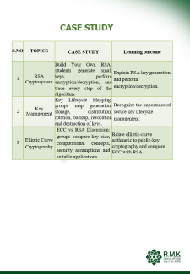
CASE STUDY
S.NO | TOPICS | CASE STUDY | Learning outcome
1 | RSA Cryptosystem | Build Your Own RSA: students generate small keys, perform encryption/decryption, and trace every step of the algorithm. | Explain RSA key generation and perform encryption/decryption.
2 | Key Management | Key Lifecycle Mapping: groups map generation, storage, distribution, rotation, backup, revocation and destruction of keys. | Recognize the importance of secure key lifecycle management.
3 | Elliptic Curve Cryptography | ECC vs RSA Discussion: groups compare key size, computational concepts, security assumptions and suitable applications. | Relate elliptic-curve arithmetic to public-key cryptography and compare ECC with RSA.

Slide 16
ACTIVITY BASED LEARNING
1. Diffie Hellman Key Exchange
Activity Title: “Secret Key Without Sharing the Secret”
Activity Type: Role Play + Hands-on Calculation + Simulation
Materials Required
Whiteboard / chart
Calculators (or mobile)
Worksheets with modular arithmetic steps
Activity Procedure
Step 1: Setup (Instructor Demonstration) – 10 mins
Step 2: Role Play (Student Interaction) – 20 mins
Step 3: Attacker Perspective – 10 mins
Step 4: Reflection & Discussion – 10 mins
2. RSA Cryptosystem
Activity Title: “Encrypt, Send, Decrypt – The RSA Mission”
Activity Type: Role Play + Guided Calculation + Problem Solving
Materials Required
Worksheets (with step-by-step RSA process)
Calculator / mobile
Whiteboard
Activity Procedure
Step 1: Concept Introduction – 10 mins
Step 2: Group Role Play – 25 mins
Step 3: RSA Key Generation (Bob’s Task)
Step 4: Encryption (Alice’s Task) – 10 mins
Step 5: Decryption (Bob’s Task) – 10 mins
Step 6: Attacker Perspective – 10 mins

Slide 17
ACTIVITY BASED LEARNING
Euler’s Totient Function
Activity Title: “Coprime Counting Challenge”
Activity Type: Group Work + Exploration + Pattern Discovery
Activity Steps
Step 1: Manual Counting (15 mins)
Step 2: Pattern Discovery (10 mins)
Step 3: Formula Application (10 mins)
Step 4: Cryptography Link (10 mins)

Slide 18
MATHEMATICS OF ASYMMETRIC KEY CRYPTOGRAPHY
Prime
An integer p is said to be a prime if p>=2 and its only divisors are the trivial divisors 1 and p.
An integer greater than 2 that is not prime is said to be composite.
Examples of Prime: 2, 3, 5, 7, 11, 13, 17, 19, 23, 29, 31, 37, 41, 43, 47, 53, 59, ...
Examples of Composite: 4, 6, 8, 9, 10, 12, 14, 15,...
Fermat’s Theorem
If p is prime and a is a positive integer not divisible by p, then
a^{p-1} ≡ 1 (mod p)
An alternative form of Fermat’s theorem is also useful: If is prime and is a positive integer, then a^{p} ≡ p (mod p)
Example:
8¹⁹⁻¹ ≡ 1 mod 19
8² ≡ 7 mod 19 8⁴ ≡ 11 mod 19 8⁸ ≡ 7 mod 19 8¹⁶ ≡ 11 mod 19
8¹⁸ ≡ 77 ≡ 1 mod 19
Proof:
Consider a set of positive integers less than p: S = {1, 2, … p-1}
Another set X = {a mod p, 2a mod p, … (p-1)a mod p} which is multiple of a mod p
the set S.
None of the elements of X is equal to zero because p does not divide a. All elements of X are unique.
S ≡ X mod p (Since X is permutation of S)
Multiplying the numbers in both sets (S and X) and taking the result mod yields
[1 × 2 × … (p-1)] mod p = [a × 2a × … (p-1)] mod p [a × 2a × … (p-1)] ≡ [1 × 2 × … (p-1)] mod p
a^{p-1} (p-1)! ≡ (p-1) ! mod p a^{p-1} ≡ 1 (mod p)

Slide 19
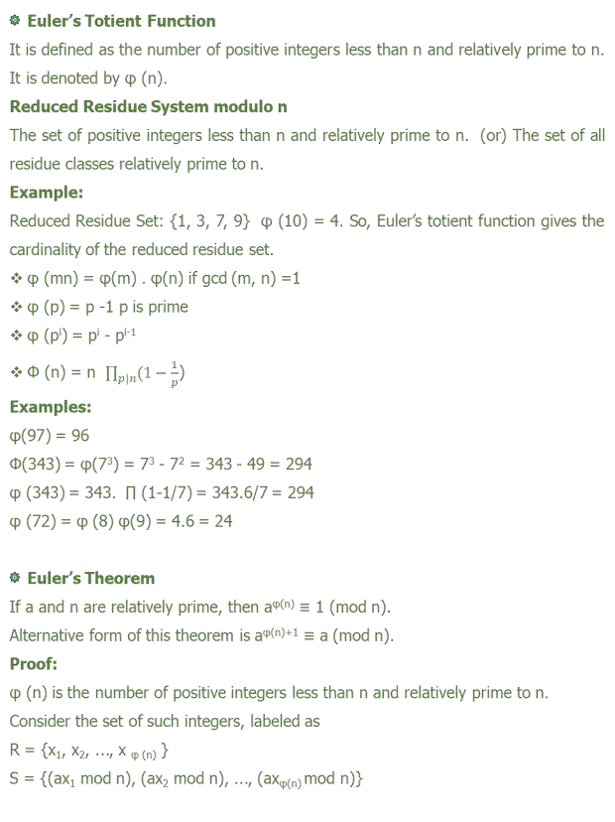
MATHEMATICS OF ASYMMETRIC KEY CRYPTOGRAPHY

Slide 20
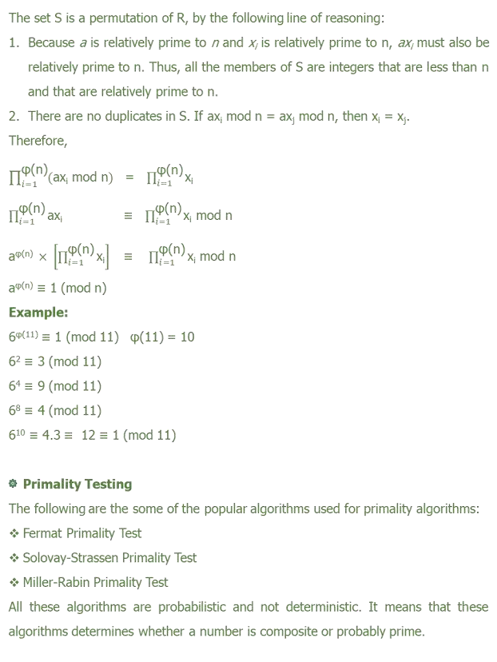
MATHEMATICS OF ASYMMETRIC KEY CRYPTOGRAPHY

Slide 21
MATHEMATICS OF ASYMMETRIC KEY CRYPTOGRAPHY
Deterministic Algorithm: AKS Primality Test
This algorithm determines whether a number is prime or not with 100% probability. But this algorithm is not as efficient as Miller-Rabin algorithm.
Miller-Rabin Primality Test
Find integers k, q, with k > 0, q odd, so that (n -1 = 2^{k}q);
Select a random integer a, 1 < a < n-1;
if a^{q} mod n = 1 then return (“inconclusive”);
for j = 0 to k -1 do
if a^{2jq} mod n = n -1 then return (“inconclusive”)
return(“composite”);
Example: n=29
n-1 = 28 = 2² × 7 where k=2 and q=7. Let a=2. Test 1: To check if a^{q} mod n = 1
2⁷ = 128 ≡ 12 ≢ 1 (So Test 1 fails)
Test 2: To check for j = 0 to k -1 do if a^{2jq} mod n = n -1 j=0, 2^{1×7} mod 29 = 2⁷ mod 29 = 12 ≠ 28
J=1, 2^{2×7} mod 29 = 2¹⁴ ≡ 144 ≡ 28 mod 29 (Test 2 passes) Therefore 29 is probably prime.
Probability of a composite number passing Miller-Rabin Test is (¼)^{t}, where t is
number of trials or tests with t different values of a. So for t=10, the probability that
a nonprime number will pass all ten tests is less than 10⁻⁶.
Strong Pseudoprime
If n is composite and passes the Miller-Rabin test for the base a, then n is called a strong pseudoprime to the base.
Example: Show that 2047 is a strong pseudoprime to the base 2.
Let n = 2047 a=2
n-1 = 2046 = 1023 x 2¹ k=1, q=1023

Slide 22
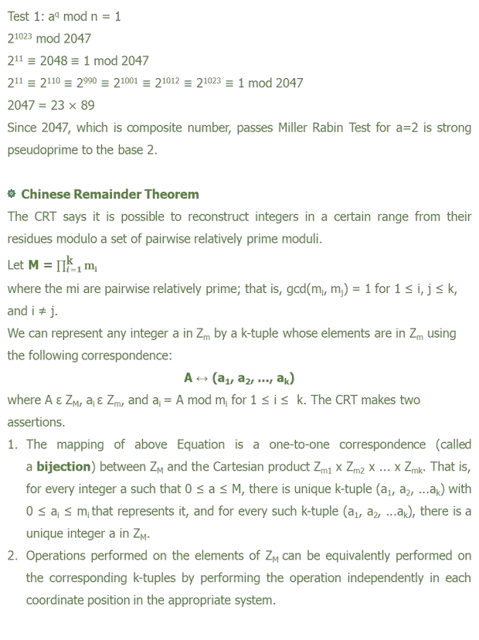
MATHEMATICS OF ASYMMETRIC KEY CRYPTOGRAPHY

Slide 23
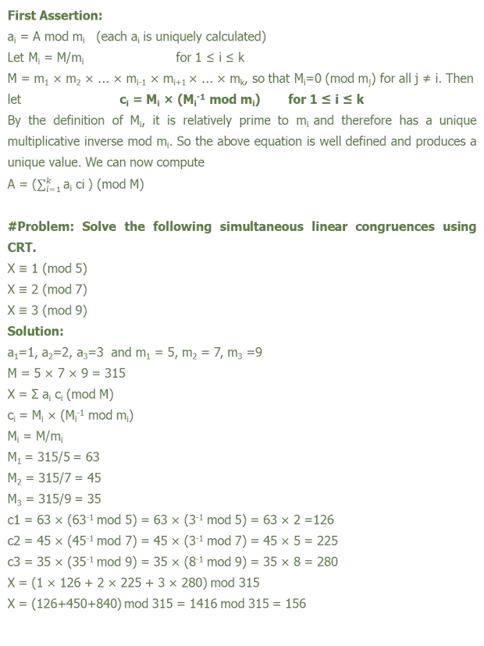

Slide 24
Second Assertion:
It follows from rules for modular arithmetic.
If A ↔ (a₁, a₂, ..., a_{k}) and B ↔ (b₁, b₂, ..., b_{k}) then
(A + B) mod M ↔ ((a₁ + b₁) mod m₁, ..., (a_{k} + b_{k}) mod m_{k})
(A - B) mod M ↔ ((a₁ - b₁) mod m₁, ..., (a_{k} - b_{k}) mod m_{k})
(A × B) mod M ↔ ((a₁ × b₁) mod m₁, ..., (a_{k} × b_{k}) mod m_{k})
One of the useful features of the Chinese remainder theorem is that it provides a way to manipulate (potentially very large) numbers mod M in terms of tuples of smaller numbers.
Example:
To represent 959 mod 2491 as a pair of numbers mod 47 and 53. Given: m₁ = 47 and m₂ = 53 M = 2491 A = 959
M₁ = M/m₁ = 2491/47 = 53
M₁ = 53 mod 47 = 6 mod 47 = 8 mod 47
-1 -1 -1
M₂ = M/m₂ = 2491/53 = 47
M₂ = 47 ≡ -9 ≡ 44 mod 53
-1 -1
A1 | A2 | A3 | B1 | B2 | B3 | Q =(A3/B3)
1 | 0 | 53 | 0 | 1 | 47 | 1
0 | 1 | 47 | 1 | -1 | 6 | 7
1 | -1 | 6 | -7 | 8 | 5 | 1
-7 | 8 | 5 | 8 | -9 | 1
959 is represented as (19, 5) as 959 mod 47 = 19 and 959 mod 53 = 5
To add 648 to 959,
(648) ↔ (648 mod 47, 648 mod 53) = (37, 12)
(648+959) mod 2491 ↔ (37+19 mod 47, 12+5 mod 53) = (9, 17)
To verify: (9, 17) ↔ a₁M₁M₁ + a₂M₂M₂ mod M
-1 -1
= [ (9) (53) (8) + (17) (47) (44)] mod 2491
= [3816 + 35156] mod 2491 = 1607 (648+959=1607) mod 2491

Slide 25
MATHEMATICS OF ASYMMETRIC KEY CRYPTOGRAPHY
Order of a (mod n)
If a and n are relatively prime, then there is atleast one integer m that satisfies a^{m} ≡ 1 (mod n) m is the smallest positive integer
The order of a modulo n is usually written as m = ord_{n}(a)
Example:
7¹ ≡ 7 mod 19 7² ≡ 11 mod 19 7³ ≡ 1 mod 19
m = ord₁₉ (7) = 3
The sequence is periodic 7^{3+j} ≡ 7³7^{j} ≡ 7^{j} mod 19
7¹ ≡ 7⁴ ≡ 7⁷ ≡ 7 mod 19 7² ≡ 7⁵ ≡ 7⁸ ≡ 11 mod 19
Primitive Roots
Any base integer a which generates (via powers) the reduced residue class set modulo n, then such integer a is called as primitive root of modulus n.
If a is a primitive root of n, then its powers a, a², a³, …, a^{φ(n)} are distinct (mod n) and are all relatively prime to n. Moreover a^{φ(n)} ≡ 1 (mod n)
Example 1: 6 is primitive root of 11
6¹ ≡ 6 mod 11 | 6⁴ ≡ 9 mod 11 | 6⁷ ≡ 8 mod 11 | 6¹⁰ ≡ 1 mod 11
6² ≡ 3 mod 11 | 6⁵ ≡ 10 mod 11 | 6⁸ ≡ 4 mod 11
6³ ≡ 7 mod 11 | 6⁶ ≡ 5 mod 11 | 6⁹ ≡ 2 mod 11
Reduced Residue Set of 11 = {1, 2, 3, 4, 5, 6, 7, 8, 9, 10}
Example 2: 3 is primitive root of 10
3¹ ≡ 3 mod 10 3² ≡ 9 mod 10 3³ ≡ 7 mod 10
Reduced Residue Set of 10 = {1, 3, 7, 9}
3⁴ ≡ 1 mod 10
The integers having primitive roots are 2, 4, p^{n} and 2p^{n}, where p is any odd prime and n is a positive integer.
The number of primitive roots modulo n, if there are any, is equal to ɸ (ɸ(n))

Slide 26
MATHEMATICS OF ASYMMETRIC KEY CRYPTOGRAPHY
Example: To check whether 6 is primitive root of 11 ɸ(n) = ɸ(11) = 10 = 2.5 (prime factors)
Test a=6:
6^{10/5} = 6² ≡ 36 ≡ 3 ≢ 1 mod 11
6^{10/2} = 6⁵ ≡ 3.3.6 ≡ 10 ≢ 1 mod 11
6 is primitive root of 11
Discrete Logarithms (Index)
b ≡ a^{i} (mod p) where 0 ≤ i ≤ (p -1)
This exponent i is referred to as the discrete logarithm of the number b for the base a (mod p). This value is denoted as dlog_{a,p}(b).
dlog_{a,p}(1) = 0 because a⁰ mod p = 1 mod p =1 dlog_{a,p}(b) = 1 because a¹ mod p = b
Methods to compute discrete logarithms:
The Pohlig-Hellman Algorithm
Baby Step, Giant Step
The Index Calculus
Example:
dlog_{2,11} (7) = ? Finding i such that 2^{i} mod 11 = 7
Using Brute-force method:
2 mod 11 = 2
2³ mod 11 = 8
2⁵ mod 11 = 10
2² mod 11 = 4
2⁴ mod 11 = 5
2⁶ mod 11 = 9
2⁷ mod 11 = 7
b | 2 | 4 | 8 | 5 | 10 | 9 | 7
dlog_{2,11} (b) | 1 | 2 | 3 | 4 | 5 | 6 | 7
Even though discrete logarithms is not a one-way trap-door function, it is a hard problem. That is, it is infeasible to compute discrete logarithms.

Slide 27
ASYMMETRIC KEY CIPHERS
RSA
RSA was developed by Ron Rivest, Adi Shamir, and Len Adleman at MIT in 1977. It is a public-key cryptographic algorithm.
The RSA scheme is a block cipher in which the plaintext and ciphertext are integers
between 0 and n - 1 for some n.
A typical size for n is 1024 bits, or 309 decimal digits.
Applications of RSA
Key Exchange in TLS, WTLS etc.
Producing Digital Signatures in SSL Certificate, PGP, S/MIME etc.
Encrypting Symmetric Keys in PGP, S/MIME etc.
Algorithm Description
Let Plaintext block - M, Ciphertext block - C C = Me mod n
M = C^{d} mod n = (Me)^{d} mod n = M^{ed} mod n
Both sender and receiver must know the value of n.
Sender knows the value of e and only receiver knows the value of d. Public Key PU = {e, n}
Private Key PR = {d, n}
For this algorithm to be satisfactory for public-key encryption,
requirements must be met.
the following
It is possible to find values of e, d, n such that M^{ed} mod n = M for all M < n.
It is relatively easy to calculate Me mod n and C^{d} mod n for all values of M < n.
It is infeasible to determine d given e and n. ɸ(n) = ɸ(pq) = ɸ(p) ɸ(q) = (p-1) (q-1)
ed mod ɸ(n) = 1 ed ≡ 1 mod ɸ(n)
d ≡ e⁻¹ mod ɸ(n)

Slide 28
ASYMMETRIC KEY CIPHERS
RSA Algorithm User B (Receiver):
Select p,q p and q both prime, p ≠ q
Calculate n = p * q
Calculate ɸ(n) = (p - 1)(q - 1)
Select integer e, gcd (ɸ(n), e) = 1; 1 < e < ɸ(n)
Calculated d d ≡ e⁻¹ mod ɸ(n)
Public key PU = {e, n} Private key PR = {d, n}
Encryption by User A (Sender) with User B’s Public Key:
Plaintext: M < n Ciphertext: C = Me mod n
Decryption by User B (Receiver) with User B’s Private Key:
Ciphertext: C
Plaintext: M = C^{d} mod n Decryption using CRT M = C^{d} mod n
V_{p} = C^{d} mod p
_{Vp = C}d mod (p-1) _{mod p}
X_{p} = q ✕ (q⁻¹ mod p)
M = (V_{p}X_{p} + V_{q}X_{q}) mod n
V_{q} = C^{d} mod q
_{Vq = C}d mod (q-1) _{mod q}
X_{q} = p ✕ (p⁻¹ mod q)
Fast Modular Exponentiation: To compute a^{b} mod n quickly Example: 2⁵⁶⁰ mod 561 = 1 (final value of f in the below table) Initial value of f = 1, a=2, n = 561, b = 560 = (1000110000)₂
f = (f × f) mod n | 1 | 4 | 16 | 256 | 460 | 412 | 166 | 67 | 1 | 1
Bi | 1 | 0 | 0 | 0 | 1 | 1 | 0 | 0 | 0 | 0
f = (f × a) mod n | 2 | - | - | - | 359 | 263 | - | - | - | -

Slide 29
ASYMMETRIC KEY CIPHERS
#Problem: Perform encryption and decryption for the parameters
p=3, q=11, e=7, M=5
Solution:
Encryption
C = Me mod n
n = p ✕ q = 3 ✕ 11 = 33 C = 5⁷ mod 33
5³ = 125 ≡ 26 mod 33
5⁶ ≡ 676 ≡ 16 mod 33
5⁷ ≡ 16.5 ≡ 80 ≡ 14 mod 33
C = 14
Decryption
M = C^{d} mod n
ɸ(n) = (p - 1)(q - 1) = 2.10 = 20
d ≡ e⁻¹ mod ɸ(n) => d ≡ 7⁻¹ mod 20 => d=3 M = 14³ mod 33
14² = 196 ≡ 31 mod 33
M = 5
Decryption Using CRT
C=14, p=3, q=11 n=33
_{Vp = C}d mod (p-1) _{mod p}
V_{p} = 14^{3 mod 2} mod 3
V_{p} = 14 mod 3 = 2
X_{p} = 11 ✕ (11⁻¹ mod 3)
X_{p} = 11 ✕ (2⁻¹ mod 3) = 11✕2 = 22
14³ ≡ 31.14 ≡ 434 ≡ 5 mod 33
_{Vq = C}d mod (q-1) _{mod q}
V_{q} = 14^{3 mod 10} mod 11
V_{q} = 14³ mod 11 ≡ 3³ mod 11 = 5
X_{q} = 3 ✕ (3⁻¹ mod 11)
X_{q} = 3 ✕ (3⁻¹ mod 11) = 3 ✕ 4 = 12
M = (V_{p}X_{p} + V_{q}X_{q}) mod n = (2.22 + 5.12) mod 33 = (44+60) mod 33 = 5
M = 5

Slide 30
ASYMMETRIC KEY CIPHERS
Security of RSA
Brute force
This involves trying all possible private keys.
Mathematical attacks
There are several approaches, all equivalent in effort to factoring the product of two primes.
Timing attacks
  These depend on the running time of the decryption algorithm.
  Countermeasures to prevent timing attacks are (i) Constant exponentiation
time, (ii) Random delay, and (iii) Blinding
Chosen ciphertext attacks
This type of attack exploits properties of the RSA algorithm.
Factoring Algorithms:
Pollard’s p-1 algorithm
Pollard’s rho algorithm
Elliptic Curve Factorization Method (ECM)
Quadratic Sieve: It is fastest method for factoring integers less than 110 digits.
Generalized number field sieve: It is the most efficient method for factoring
integers larger than 110 digits.
Generalized number field sieve and Quadratic sieve are the fastest algorithms and hence mostly used for performing mathematical attacks on RSA.

Slide 31
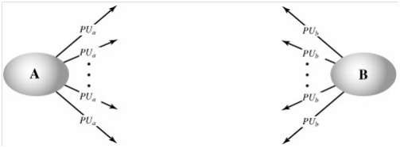
Key Distribution
Keys distribution can be categorized into public key distribution and secret key
distribution.
To distribute public keys there are various schemes like 1.Public announcement
Publicly available directory
Public key authority
Public key certificates
Public Announcement of Public Keys
In this distribution scheme the public keys are broadcasted to the large community. The limitation in this public announcement is that anyone can announce the key. Similarly a person A can pretend to be another person B and can publicly announce a public key for that user B. So when all users are sending the messages encrypted using the public key of user B it is actually can be decrypted only by user A.

Slide 32
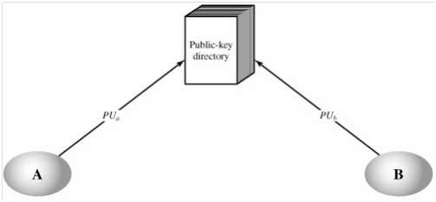
Publicly Available Directory
To overcome the drawback of the public announcement all users can share their public keys to the public directory which is maintained by an authority. Initially all users has to register in this public directory and each user is authenticated by the authority to access the public directory. So, it is not possible to perform masquerade attack. i.e., user A cannot send another person B’s key. At any point of time the keys can be replaced by the concerned user. This scheme also has a drawback that an adversary can compromise the private key shared between the user and public authority.
Public-Key Authority
To avoid the weakness in the public directory scheme, each participant has to request the public authority for user B’s public key by sending a time stamped request message. After receiving the request message, public key authority sends a response as encrypted message to the user A. Encryption is done using authority’s private key which authenticates that the message is sent by the authority. Encrypted message has B's public key, and the user A’s request message. Now if A wants to communicate with user B , user A will send an encrypted message to user B with a nonce and identifier of user A.

Slide 33
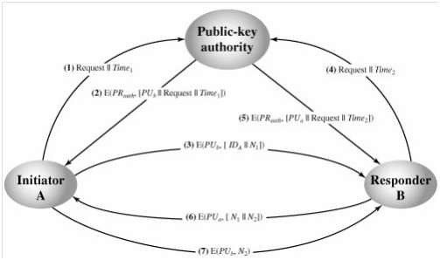
After receiving user B will send the reply as an encrypted message with the nonce sent by A and a new nonce value to uniquely identify the communication and to make an assurance that user B has received the message correctly. Later A will also send the new nonce value encrypted to make an assurance that both intended users are only communicating.
Public-Key Certificates
In the public key authority, as each user has to contact authority in-order to get the public keys. So bottleneck problem occurs. To avoid this issue each user will share the public key to the central authority who is responsible for issuing certificates to the users. Each user will be provided with certificate. So if any user wants to communicate they will exchange the certificates to authenticate themselves. Certificate will have users public key and the central authority’s private key.

Slide 34
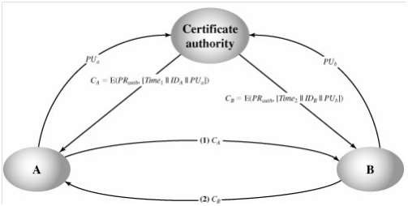
Each certificate has
CA = E(PRauth, [T||IDA||PUa])
where PRauth is the private key used by the authority and T is a timestamp. This certificate can be verified by performing
D(PUauth, CA) = D(PUauth, E(PRauth, [T||IDA||PUa])) = (T||IDA||PUa)

Slide 35
DIFFIE HELLMAN KEY EXCHANGE
Whittfield Diffie and Martin Hellman are called the inventors of public key cryptography.
Diffie Hellman key exchange is the first public key algorithm published in 1976. Diffie Hellman is a public key algorithm. It only used for key exchange. Does not used for encryption and decryption. It is based on discrete logarithm. It is widely used in security protocols and commercial products.
Primitive roots
Let ‘P’ be a prime then ‘b’ is a primitive root for P if the powers of b, 1, b, b2 , b3….
by including all of the residue classes mod P except 0. Hence there must be P – 1 power of b.
Example 1:
If P = 7, then 3 is a primitive root for P because the power of 3 are 1, 3, 2, 6, 4, 5.
1, 3, 32, 33, 34 , …
1, 3, 9 mod 7, 27 mod 7, 31 mod 7
1, 3, 2, 6, 4, 5.
Example 2:
If P = 13, then 2 is a primitive root for P because the power of 2 are 1, 2, 22, 23, 24 , 25 , 26 , …
1, 2, 4 mod 13, 8 mod 13, 16 mod 13, 32 mod 13m 128 mod 13, 256 mod 13
1, 2, 4, 8, 3, 6, 12, 11, 9, 5, 10, 7

Slide 36
Diffie Hellman Algorithm
Let ‘q ’ be a prime.
Given α where α < q and α ιs a primitive root of q.
User ‘A’ key generation
Select prime key XA where XA < q.
Calculate public key YA where YA = α ^{XA} mod q.
User ‘B’ generation
Select private key XB where XB < q.
Calculate public key YB where YB = α ^{XB} mod q.
Generation of secret key by user ‘A’
K = (YB)^{XA} mod q
Generation of secret key by user ‘B’
K = (YA) ^{XB} mod q
Derivation
K = (YB)^{XA} mod q
= (α ^{XB} mod q) XA mod q
= (α ^{XB} )^{XA} mod q
= (α ^{XA} )^{XB} mod q
= (α ^{XA} mod q) ^{XB} mod q
K = (YA) ^{XB} mod q

Slide 37
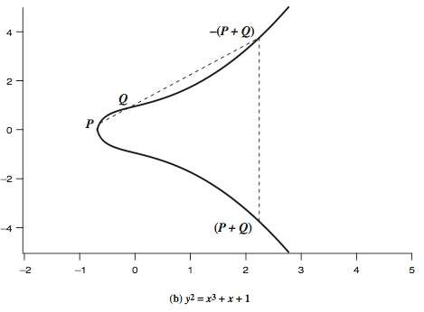
Elliptic Curve Cryptography
A major issue with the use of Public-Key Cryptography, is the size of numbers used, and hence keys being stored. Recently, an alternate approach has emerged, elliptic curve cryptography (ECC), which performs the computations using elliptic curve arithmetic instead of integer or polynomial arithmetic.
The principal attraction of ECC, compared to RSA, is that it appears to offer equal security for a far smaller key size, thereby reducing processing overhead.
Elliptic Curve
An elliptic curve is defined by an equation in two variables with coefficients. In general, cubic equations for elliptic curves take the following form, known as a Weierstrass equation:
y² + axy + by = x³ + cx² + dx + e
where a, b, c, d, e are real numbers and x and y take on values in the real numbers.
Figure Example of Elliptic Curves

Slide 38
For our purpose, it is sufficient to limit ourselves to equations of the form
y² = x³ + ax + b
where x,y,a,b are all real numbers, also define zero point O
consider set of points E(a,b) that satisfy
have addition operation for elliptic curve
  geometrically sum of P+Q is reflection of the intersection R
If three points on an elliptic curve lie on a straight line, their sum is O. hence define addition as:
O serves as the additive identity. Thus O = –O; for any point P on the elliptic curve, P + O = P. In what follows, we assume P <> O and Q <> O.
The negative of a point P is the point with the same x coordinate
but the negative of the y coordinate; that is, if P = (x, y), then –P = (x, –y). These two points can be joined by a vertical line & that P + (–P) = P – P = O.
To add two points P and Q with different x coordinates, draw a straight line between them and find the third point of intersection R. There is a unique point R that is the point of intersection (unless the line is tangent to the curve at either P or Q, in which case we take R = P or R = Q, respectively). To form a group structure, we need to define addition on these three points as follows: P + Q = –
R. ie. P + Q to be the mirror image (with respect to the x axis) of the third point of intersection as shown on slide.
The geometric interpretation of the preceding item also applies to two points, P and –P, with the same x coordinate. The points are joined by a vertical line, which can be viewed as also intersecting the curve at the infinity point. We therefore have P + (–P) = O, consistent with item (2).
To double a point Q, draw the tangent line and find the other point of intersection S. Then Q + Q = 2Q = –S.

Slide 39

With the preceding list of rules, it can be shown that the set E(a, b) is an abelian
group.
Elliptic curve arithmetic
Addition of Two Points
Let the points P = (x₁, y₁) and Q= (x₂, y₂) be in the elliptic group E_{p} (a, b), and O is the point at infinity. The rules for addition over the elliptic group E_{p} (a, b) are:
P+O=O+P=P
If x2= x1 and y2 = -y1, that is P = (x1, y1) and Q= (x2, y2)= (x₁, -y₁) = −P, then
P+Q=O.
If Q = −P, then the sum P+Q = (x₃, y₃) is given by: x₃ =𝜆² - x₁- x₂ mod p
y₃ = 𝜆 ( x₁- x₃) - y₁ mod p
Where
Subtraction of Two Points
Let the points P = (x1, y1) and Q = (x2, y2) be in the elliptic group Ep (a,
b). The rules for subtraction over the elliptic group Ep (a, b) are:
P−Q=P+(−Q)=P+(inverse of Q), so the inverse of Q is Q(x2, y2)= Q(x2, -y2)
= Q(x2, p-y2).
Multiplication Points by a Constant
Let the points P = (x1, y1) and the integer be k in the elliptic group Ep (a, b).
Then Pk= Add P with k times. e.g., 2P = P+P = (x1, y1) + (x1, y1) = (x3, y3).

Slide 40
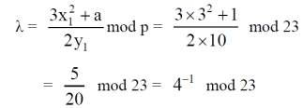
1
Point generation on Elliptic Curve
Let P = (3,10) ∈E23(1,1). Then 2P = (x3, y3) is equal to: 2P = P + P = (x1, y1) + (x1, y1) Since P=Q and x2 = x1, the values of λ, x3 and y3 are given by:
Now using extended Euclidean formula: Here, quotient = q, remainder = r and t = t₁ – qt₂
Q | r₁ | r₂ | R | t₁ | t₂ | t
5 | 23 | 4 | 3 | 0 | 1 | -5
1 | 4 | 3 | 1 | 1 | -5 | 6
3 | 3 | 1 | 0 | -5 | 6 | -23
 | 1 | 0 |  | 6 | -23
Since, r₁ = 1. So that, M₁ = t_{1.} The extended Euclidean Algorithm gives
-1
t₁ = 6. So, the multiplicative inverse ( M⁻¹ ) is 6 mod 23 =6. x₃ = ² - x₁ - x₂ = 6²−3−3 mod 23 = 30 mod23 = 7
y₃ = (x₁ - x₃ ) - y₁ = 6×(3−7)−10 mod 23 =−34 mod 23 = 12
Therefore 2P = (x₃, y₃) = (7, 12).
The multiplication kP is obtained by doing the elliptic curve addition operation k times by following the same additive rules.

Slide 41
ECC Diffie-Hellman
The elliptic curve analog of Diffie-Hellman key exchange, which is a close analogy given elliptic curve multiplication equates to modulo exponentiation. Key exchange using elliptic curves can be done in the following manner.
First pick a large integer q, which is either a prime number p or an integer of the form 2^{m} and elliptic curve parameters a and b for Equation
y²mod p = (x³ + ax + b) mod p
This defines the elliptic group of points E_{q}(a, b). Next, pick a base point G = (x₁, y₁) in E_{q}(a, b) whose order is a very large value n. The order n of a point G on an elliptic curve is the smallest positive integer n such that nG = O. So E_{q}(a, b) and G are parameters of the cryptosystem known to all participants. A key exchange between users A and B can then be accomplished as shown. To break this scheme, an attacker would need to be able to compute k given G and kG, which is assumed hard.
A key exchange between users A and B can be accomplished as follows
A selects an integer nA less than n. This is A’s private key. A then generates a public key
P_{A} = n_{A} * G; the public key is a point in Eq(a, b).
B similarly selects a private key n_{B} and computes a public key P_{B}.
A generates the secret key k = n_{A} * P_{B}. B generates the secret key k = n_{B} * P_{A}.
The two calculations in step 3 produce the same result because n_{A} * P_{B} = n_{A} * (n_{B} * G) = n_{B} * (n_{A} * G) = n_{B} * P_{A}
To break this scheme, an attacker would need to be able to compute k given G and kG, which is assumed to be hard.As an example,6 take p = 211; Ep(0,-4), which is equivalent to the curve y2 = x3 - 4; and G = (2, 2). One can calculate that 240G = O.
A’s private key is n_{A} = 121, so A’s public key is P_{A} = 121(2, 2) = (115, 48). B’s private key is n_{B} = 203, so B’s public key is 203(2, 3) = (130, 203).
The shared secret key is 121(130, 203) = 203(115, 48) = (161, 69).

Slide 42
ECC Encryption/Decryption
Several approaches to encryption/decryption using elliptic curves have been analyzed in the literature. This one is an analog of the ElGamal public-key encryption algorithm. The sender must first encode any message M as a point on the elliptic curve P_{m}. Note that the ciphertext is a pair of points on the elliptic curve. The sender masks the message using random k, but also sends along a “clue” allowing the receiver who know the private-key to recover k and hence the message. For an attacker to recover the message, the attacker would have to compute k given G and kG, which is assumed hard.
Key Generation:
Each user chooses private key n_{A}<n compute public key P_{A}=n_{A}G
Encryption:
P_{m} : C_{m}={kG, P_{m}+kP_{b}}, k random
Decryption:
C_{m} compute:
P_{m}+kP_{b}–n_{B}(kG) = P_{m}+k(n_{B}G)–n_{B}(kG) = P_{m}
Let us consider a simple example. The global public elements are q = 257;
Eq(a, b) = E₂₅₇(0, -4), which is equivalent to the curve y² = x³ - 4; and G =(2, 2).
Bob’s private key is n_{B} = 101, and his public key is P_{B} = n_{B}G = 101(2, 2)
= (197, 167).
Alice wishes to send a message to Bob that is encoded in the elliptic point
P_{m} = (112, 26).

Slide 43
Alice chooses random integer k = 41 and computes kG =41(2, 2) = (136, 128),
kP_{B} = 41(197, 167) = (68, 84)
P_{m} + kP_{B} = (112, 26)+ (68, 84) = (246, 174).
Alice sends the ciphertext
C_{m} = (C₁, C₂) = {(136, 128),(246, 174)} to Bob.
Bob receives the ciphertext and computes
C₂ - n_{B}C₁ =(246, 174) - 101(136, 128)
= (246, 174) - (68, 84)
= (112, 26).
ECC Security
The security of ECC depends on how difficult it is to determine k given kP and P. This is referred to as the elliptic curve logarithm problem. The fastest known technique for taking the elliptic curve logarithm is known as the Pollard rho method. Compared to factoring integers or polynomials, can use much smaller numbers for equivalent levels of security. Comparable Key Sizes for Equivalent Security shown in below table:
Symmetric scheme (key size in bits) | ECC-based scheme (size of n in bits) | RSA/DSA (modulus size in bits)
56 | 112 | 512
80 | 160 | 1024
112 | 224 | 2048
128 | 256 | 3072
192 | 384 | 7680
256 | 512 | 15360

Slide 44
ASSIGNMENT UNIT III
S.No | Questions | CO | K
SET 1
1. | A number n=561 passes Fermat's Little Theorem for base a=2 Prove that 561 is composite. Explain why it is a Carmichael number. Show how Miller–Rabin primality test detects it. . | CO3 | K5
2. | Design a hybrid primality test: Combine Fermat + Miller-Rabin Analyze worst-case time complexity Evaluate probability of false positives after 5 iterations | CO3 | K6
SET 2
3. | Solve and justify uniqueness: Verify solution using Chinese Reminder Theorem. | CO3 | K4
4. | Show how CRT reduces decryption complexity from O(n³)to smaller components. Compute decryption using CRT for p=11, q=13, d=7, C=9. | CO3 | K4
Input Matrix
Real life case study
Whether symmetric algorithm or Public key cryptography is widely used in
current scenario. Explain

Slide 45
ASSIGNMENT UNIT III
S.No | Questions | CO | K
SET 3
5. | Given p = 23, g =5. Alice a = 6, Bob b = 15. Compute Shared key using Diffie-Hellman Key Exchange. Simulate a Man-in-the-Middle Attack. Show mathematically how attacker derives different keys. | CO3 | K3, K4
6. | Given p = 23, g = 5, x = 6 (private key) Message M = 10, random k = 7. Compute public key. Encrypt using El-Gamal Encryption. Decrypt and verify correctness. | CO3 | K5
SET 4
7. | Post-Quantum Analysis - Evaluate impact of Shor's Algorithm on: RSA Diffie-Hellman ECC | CO3 | K5
8. | Compare Hardness: Integer factorization vs elliptic curve discrete log problem Why Elliptic Curve Cryptography achieves same security with smaller keys? | CO3 | K5
SET 5
9. | Construct an algorithm for efficient modular exponentiation and analyze its time complexity. | CO3 | K6
10. | Propose a secure key distribution framework using Public Key Infrastructure and blockchain. | CO3 | K6
Input Matrix
Real life case study
Whether symmetric algorithm or Public key cryptography is widely used in
current scenario. Explain

Slide 46
AI Based Examples
1. AI-Assisted Primality Testing and Factorization
Concept:
Primes, Primality Testing, Factorization
AI Example:
An AI-assisted primality testing and factorization.
Scenario:
Students use an AI tool and asked to explain whether they are prime and demonstrate suitable primality-testing/factorization steps.
AI analyzes:
Verify the AI-generated solution manually.
Real-life applications:
Educational purposes to understand the primality testing.

Slide 47
2. AI Tutor for Euler’s Totient, Fermat’s and Euler’s Theorems
Concept: Euler’s Totient Function, Fermat’s & Euler’s Theorem
Usage:
AI generates numerical problems of different difficulty levels and provides step-by-step hints rather than directly giving answers. Students solve first and compare their solutions with AI explanations.
3. AI-Based RSA Key Generation Simulator
Concept: RSA Cryptosystem, Key Distribution
Usage:
Students use AI to generate a small RSA example using selected primes, calculate n, ϕ(n), public/private keys and demonstrate encryption/decryption. AI is also asked to explain each step.
4. AI Simulation of Diffie–Hellman Key Exchange
Concept: Diffie–Hellman Key Exchange
Usage:
AI acts as Alice and Bob and generates a guided numerical simulation. Students independently calculate the public values and shared secret and identify whether both parties obtain the same key.
5. AI-Based RSA vs ECC Security Analyst
Concept: Elliptic Curve Arithmetic, ECC, RSA
Usage:
Students ask AI to compare RSA and ECC for a given application such as mobile banking, IoT or secure messaging. They evaluate key size, computational requirements, security assumptions and suitability.

Slide 48
TWO MARKS Q & A
1. Define one-way function. (CO3, K1)
A one-way function is one that maps a domain into a range such that every function
value has a unique inverse, with the condition that the calculation of the function is
easy whereas the calculation of the inverse is infeasible:
Y = f(X) X = f⁻¹(Y)
easy infeasible
2. Define trap-door one-way function. (CO3, K1)
It is one that is easy to calculate in one direction and infeasible to calculate in the other direction unless certain additional information is known. With the additional information the inverse can be calculated in polynomial time.
Y = f_{k}(X) X = f⁻¹ (Y)
k
X = f⁻¹ (Y)
k
easy, if k and X are known easy, if k and Y are known
infeasible, if Y is known but k is not known
3. Compare secret key and public key cryptography. (CO3, K2)
S.No. | Secret Key Cryptography | Public Key Cryptography
1 | The key is shared between sender and receiver. It is not known to others. | Private key of b user is known only to that user. Public key of b user is known to group of users.
2 | Encryption and decryption algorithms use same key. Hence it is known bs symmetric key encryption. | Encryption and decryption algorithms use different keys. Hence it is known as asymmetric key encryption.

Slide 49
4. State Fermat’s theorem. (CO3, K1)
If p is prime and a is a positive integer not divisible by p, then a^{p-1} ≡ 1 (mod p). Example: 7¹⁸ ≡ 1 (mod 19)
5. Define Euler’s totient function. (CO3, K1)
It is defined as the number of positive integers less than n and relatively prime to n. It is denoted by φ (n). Example: φ (11) = 10, φ (10) = 4
6. State Euler’s theorem. (CO3, K1)
If b and n are relatively prime, then a^{φ(n)} ≡ 1 (mod n). Example: 13⁸ ≡ 1 (mod 20)
7. Define primitive roots. (CO3, K1)
If a is a primitive root of n, then its powers a, a², a³, …, a^{φ(n)} are distinct (mod n) and are all relatively prime to n. Moreover a^{φ(n)} ≡ 1 (mod n).
8. Define discrete logarithm. (CO3, K1)
b ≡ a^{i} (mod p) where 0 ≤ i ≤ (p -1)
This exponent i is referred to as the discrete logarithm of the number b for the base a (mod p). This value is denoted as dlog_{a,p}(b).
9. The Miller-Rabin test can determine if a number is not prime but cannot determine if a number is prime. How can such an algorithm be used to test for primality? (CO3, K2)
If the number of Miller-Rabin tests t=1, the probability that a nonprime number will
pass the test is less than 0.25. If the number of tests increased to t=10, then probability that a nonprime number will pass all ten tests is less than 10⁻⁶. In general getting false positive is (1/4)^{t}. So by choosing t different value of a, one can close to 100% confidently determine a number as prime.

Slide 50
10. List out the three broad categories of applications of public-key cryptosystems (CO3, K2)
Encryption and decryption
Digital Signature
Key Exchange
11. How is authentication and confidentiality achieved by asymmetric encryption system? (CO3, K2)
Confidentiality is achieved when the sender encrypts the message with the
recipient’s public key.
Authentication is achieved when the sender signs a message with its (sender’s) private key.
12. What is the idea behind the security of RSA?
The security of RSA lies in the fact that Integer Factorization (factoring an integer into their prime factors) is hard.
13. List out the different primality-testing algorithms. (CO3, K2)
Fermat primality test
Miller-Rabin primality test
Solovay-Strassen primality test
14. List out the different types of attacks on RSA? (CO3, K2)
Low Exponent attack
Short plaintext attack
Timing attack
Mathematical attack (Factoring)

Slide 51
15. List out the different factorization algorithms.
Quadratic Sieve
Generalized number field sieve
Elliptic Curve Factorization Method (ECM)
16. Define man-in-the middle-attack. (CO3, K1)
An attacker interposes during key exchange, acting as the client to the server and as the server to the client. This attack involves persuading the client and server to believe that they are talking to each other when in fact the communication is going through an intermediate attacker.
17. Define an elliptic curve. (CO3, K1)
An elliptic curve is defined by an equation in two variables with coefficients. For cryptography, the variables and coefficients are restricted to elements in a finite field.
y² = x³ + ax + b

Slide 52
18. Perform encryption and decryption using RSA Alg. for the following. P=7; q=11; e=17;M=8.
n = pq
n = 7*11=77 Φ(n)=(p-1) (q-1)
=6*10 = 60
e =17 d =27
C = M^e mod n
C = 817 mod 77
= 57
M = Cd mod n
= 5727 mod 77 = 8
19. Specify the applications of the public key cryptosystem?
The applications of the public-key cryptosystem can classified as follows Encryption/Decryption: The sender encrypts a message with the recipient’s public
key.
Digital signature: The sender “signs” a message with its private key. Signing is achieved by a cryptographic algorithm applied to a message or to a small block of data that is a function of the message.
Key Exchange: Two sides cooperate to exchange a session key. Several different approaches are possible, involving the private key(s) of one or both parties.

Slide 53
20. List four general characteristics of schema for the distribution of the
public key?
The four general characteristics for the distribution of the public key are Public announcement
Publicly available directory Public-key authority Public-key certificate
21. What is a public key certificate?
The public key certificate is that used by participants to exchange keys without contacting a public key authority, in a way that is as reliable as if the keys were obtained directly from the public-key authority. Each certificate contains a public key and other information, is created by a certificate authority, and is given to a participant with the matching private key.
22. What is key distribution center?
A key distribution center is responsible for distributing keys to pairs of users such as hosts, processes, applications. Each user must share a unique key with the key distribution center for purposes of key distribution.
23. List out the attacks to RSA.
Brute force - Trying all possible private keys.
Mathematical attacks - The approaches to factor the product of two prime numbers. Timing attack - Depends on the running time of the decryption algorithm.

Slide 54
PART B
1. Users Alice and Bob use the Diffie Hellman key exchange
technique with common prime q = 83 and primitive root α = 5.
If Alice has a private key as 6, what is public key of Alice?
If Bob has a private key as 10 , what is the public key of Bob?
What is the shared secret key?
Users A and B use the Diffie-Hellman key exchange technique, a common prime p=71 and a primitive root g=7 are used. If user A has private key X A =5, what is A’s public key Y A ? If user B has private key X B =12, what is B’s public key Y B ? What is the shared secret key?
3. Explain briefly about man-in-the-middle man attack.
4. Find the secret key shared between user A and user B using Diffie
Hellman algorithm for the following q=353 , α = 3, XA = 45 and
XB = 50
5. Explain ElGamal Cryptosystem
6. Explain key distribution techniques.
7. Using Elliptic curve encryption/decryption scheme, key exchange between users A and B is accomplished. The cryptosystem parameters are, elliptic group of points E 11 (1,6) and point G on the elliptic curve is G=(2,7). B’s secret key is n B =7. Now when (i) A wishes to encrypt the message Pm=(10,9) and chooses the random value K=3. Determine the ciphertext Cm. Find out B’s public key PB.

Slide 55
8. State Chinese Remainder Theorem and find X for the given set of
congruent equations using CRT
X ≡ 1 (mod 5)
X ≡ 2 (mod 7)
X ≡ 3 (mod 9)
X ≡ 4 (mod 11)
9. Perform encryption and decryption using RSA algorithm. Given: p=5; q=11;
e=3; M=9. Explain the strength of RSA.

Slide 56
GATE QUESTIONS
1. RSA Cryptosystem – GATE CSE 2019
Question:
In an RSA cryptosystem, the value of the public modulus parameter n is 3007. If it is also known that (n)=2880, where ϕ denotes Euler's Totient Function, then the prime factor of n which is greater than 50 is ______.
Answer: 97
Explanation:
Given n=3007 and ϕ(n)=2880. Since n=p×q and ϕ(n)=(p−1)(q−1), we can factor n to find its prime factors. Testing for divisibility, we find 3007=31×97. Among these, the prime factor greater than 50 is 97.
2. RSA Cryptosystem – GATE CSE 2017
Question:
In an RSA cryptosystem, a participant A uses two prime numbers p=13 and q=17 to generate her public and private keys. If the public key of A is 35, then the private key of A is ______.
Answer: 11
Explanation:
Compute n=p×q=13×17=221 and ϕ(n)=(p−1)(q−1)=12×16=192. The private key d is the modular multiplicative inverse of e=35 modulo ϕ(n)=192. Solving 35×d≡1mod 192, we find d=11.
3. Diffie-Hellman Key Exchange – GATE CSE 2005
Question:
Suppose that two parties A and B wish to set up a common secret key (D-H key) between themselves using the Diffie-Hellman key exchange technique. They agree on 7 as the modulus and 3 as the primitive root. Party A chooses 2 and party B chooses 5 as their respective secrets. Their D-H key is:
Options:
A. 3
B. 4
C. 5
D. 6
Answer: B. 4
Explanation:
Public parameters: modulus p=, base g=3. Private keys: A chooses a=2, B chooses b=5. A computes A=ga mod p=32 mod 7=2, B computes B=gbmod p=35mod 7=5 . Shared secret: A computes s=Bamod p=52mod 7=4, B computes s=Abmod p=25mod 7=4. So, the shared key is 4.

Slide 57
4. Euler's Totient Function – GATE CSE 2005
Question:
If ϕ is Euler's Totient function, then ϕ(92)= ______.
Answer: 44
Explanation:
The prime factorization of 92 is 22×23. Euler's Totient function ϕ(n) for n=pa×qb is ϕ(n)=n×(1−(1/p))×(1−(1/q)). Thus, ϕ(92)=92×(1−(1/2))×(1−(1/23))=92×(1/2)×(22/23)=44.
5. Chinese Remainder Theorem – GATE CSE 2007
Question:
Find the smallest positive integer x such that:
x≡3mod 5
x≡4mod 7
Answer: 24
Explanation:
Using the Chinese Remainder Theorem, we can find a unique solution modulo 5×7=35. Solving the congruences, we find x=24 satisfies both conditions.
6.Primality Testing – GATE CSE 2013
Question:
Which of the following numbers is a prime?
Options:
A. 91
B. 97
C. 111
D. 143
Answer: B. 97
Explanation:
Among the options, 97 is a prime number. The others can be factored:
91 = 7 × 13
111 = 3 × 37
143 = 11 × 13
7. Fermat’s Theorem – GATE CSE 2019
The value of 351 mod 5 is_________.
Answer
Correct answer is 2
10. Primality Testing – GATE CSE 2013
Which of the following is a probabilistic primality test?
A. Trial Division
B. AKS Primality Test
C. Fermat Primality Test
D. Sieve of Eratosthenes
Answer: C. Fermat Primality Test
Explanation: The Fermat Primality Test is a probabilistic method that can identify composite numbers but may falsely identify some composites (Carmichael numbers) as primes.

Slide 58
Supportive online Certification courses
NPTEL
Cyber Security and Privacy
Ethical Hacking
Computational number theory and cryptography
COURSERA
Cryptography
Applied Cryptography
Number theory and cryptography Cryptography and Information theory
Asymmetric cryptography and key management Symmetric Cryptography
UDEMY
Introduction to Cryptography Cryptography with python
Applied Cryptography with Python
Complete Cryptography master class

Slide 59
Real Time Applications in day to day life and industry
Secure Communication
Diffie Hellman Algorithm can be used in
  Transport Layer Security (TLS) / Secure Sockets Layer (SSL)
  Public Key Infrastructure (PKI)
  Internet Key Exchange (IKE)
  Internet Protocol Security (IPSec)

Slide 60
COMPLEX ENGINEERING PROBLEMS
Problem 1: Secure Key Exchange for a Distributed Communication System
Design a secure key-establishment mechanism for a distributed communication system in which two users need to establish a common secret key over an insecure public network without directly transmitting the secret key.
Tasks:
Analyze mathematical requirements.
Implement Diffie–Hellman.
Analyze MITM and key management.
Evaluate security, complexity & scalability.
Problem 2: Design of a Secure RSA-Based Data Exchange System
A financial application requires secure exchange of sensitive information between a client and server. Design an RSA-based asymmetric cryptographic solution that provides secure key generation, encryption/decryption and appropriate key management.
Tasks:
Prime testing, factorization & φ(n).
Generate RSA keys and encrypt/decrypt.
Apply Fermat, Euler & CRT.
Design key-management strategy & evaluate.
Problem 3: ECC-Based Secure Communication for Resource-Constrained Devices
Design a secure communication mechanism for an IoT/mobile environment where devices have limited computational power, memory and communication bandwidth. Evaluate whether Elliptic Curve Cryptography (ECC) is more suitable than RSA.
Tasks:
Elliptic-curve arithmetic.
Demonstrate ECC key generation.
Compare RSA and ECC.
Recommend solution based on engineering constraints.

Slide 61
SDG ACTIVITIES FOR THE COURSE
Activity 1: Interactive Cryptography Learning Activity
SDG: SDG 4-Quality Education
Course Topics Covered: Primes, Primality Testing, Euler’s Totient Function, Fermat’s & Euler’s Theorem, CRT
Activity: Students work in small groups to solve progressively difficult number-theory problems using peer learning and AI-assisted verification. Each group prepares a simple learning resource explaining one mathematical concept and its cryptographic application.
Deliverables
Problem-solving worksheet
• Student-created concept map/infographic
• AI-verified solutions
• Short group presentation
Activity 2: Secure Communication System Design
SDG: SDG 9 – Industry, Innovation and Infrastructure
Course Topics Covered: RSA, Key Distribution, Key Management, Diffie–Hellman, ECC
Activity: Students design a secure communication model for an IoT/industrial application. They compare RSA, Diffie–Hellman and ECC and select an appropriate asymmetric cryptographic technique considering security, computational resources and scalability.
Deliverables
System architecture diagram
• Cryptographic algorithm flowchart
• RSA/Diffie–Hellman/ECC comparison
• Design justification and mini-report
Activity 3: Secure Digital Services Case Study
SDG: SDG 16 – Peace, Justice and Strong Institutions
Course Topics Covered: RSA, Key Management, Diffie–Hellman, ECC, Cryptographic Security
Activity: Students analyze a scenario such as online banking, e-governance or secure digital communication and identify threats to confidentiality, authentication and key management. They propose an asymmetric cryptography-based security solution.
Deliverables
Threat and risk analysis
• Secure communication architecture
• Key-management plan
• Security recommendations
• Group presentation

Slide 62
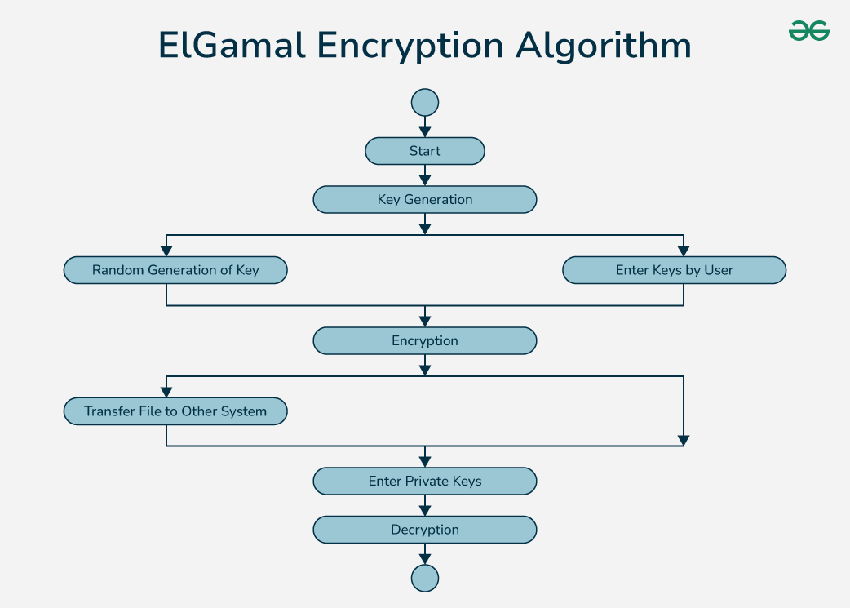
Contents beyond the Syllabus
ElGamal Encryption is a public-key cryptosystem. It uses asymmetric key encryption to communicate between two parties and encrypt the message. This cryptosystem is based on the difficulty of finding discrete logarithms in a cyclic group that is even if we know gª and g^{k}, it is extremely difficult to compute g^{ak}.
Elgamal Cryptographic Algorithm
The ElGamal cryptographic algorithm is an asymmetric key encryption scheme based on the Diffie-Hellman key exchange. It was invented by Taher ElGamal in 1985. The algorithm is widely used for secure data transmission and has digital signatures and encryption applications.
Components of the ElGamal Algorithm
Key Generation:
  Public Parameters: Select a large prime number p and a generator g of the multiplicative group Z*_{p}.
  Private Key: Select a private key x such that 1 ≤ x ≤p −2.
  Public Key: Compute h=g^{x} mod p. The public key is (p,g,h) and the private key is x.
Encryption:
  To encrypt a message M:
    Choose a random integer k such that 1 ≤ k ≤ p−2.
    Compute C₁ = g^{k} mod p.
    Compute C₂ =M⋅h^{k} mod p.
    The ciphertext is (c1,c2).
Decryption:
  To decrypt the ciphertext (c1,c2) using the private key x:
    Compute the shared secret s= C^{x}₁ mod p.
    Compute s⁻¹ mod p (the modular inverse of s).
    Compute the original message M = C₂⋅s⁻¹ mod p.

Slide 63
ASSESSMENTSCHEDULE
Assessment | Proposed Date | Actual Date
IAT I | 28.07.2026 | 04.08.2026
IAT II | 31.08.2026 | 08.09.2026
MODEL | 21.09.2026 | 28.09.2026

Slide 64
Seminar Topics
RSA Cryptosystem: From Mathematical Foundations to Secure Communication
Diffie–Hellman Key Exchange: Establishing a Secret over an Insecure Network
Elliptic Curve Cryptography: Why Smaller Keys Can Provide Strong Security
RSA vs ECC: Which Public-Key Algorithm is Better?
Chinese Remainder Theorem: Accelerating RSA Computation
Primality Testing and Prime Generation in Cryptography
Man-in-the-Middle Attack and Secure Key Exchange
Cryptographic Key Management in Modern Digital Systems
ECC Applications in IoT, Mobile Devices and Embedded Systems
Post-Quantum Cryptography: Threats to RSA and ECC

Slide 65
Mini Projects Suggestions
RSA Encryption and Decryption Implementation:
  Develop a Secure Text Messenger using the RSA
  Design a Credit Card Data Protection Application using the RSA securing the sensitive information of CVVs and card numbers.
Digital Signature Scheme Implementation:
  Develop a Secure Document Signer using DSA (Digital Signature Algorithm).
  Demonstrate a Hashed Password Cracker using the DSA.
Key Exchange Protocol Simulation:
  Simulate a Secure Key Exchange Simulation in Client-Server Network Architecture.
  Visualize the Step-by-Step Simulation of Secure Key Negotiation for Educational Use.
Secure Communication Application:
  Develop a Secure Communication App for Android using Hybrid Cryptography (RSA + AES).
  Simulate Self-Destructing Messages for Privacy-Focused Communication Apps.
Cryptographic Protocols Analysis:
  Security Analysis of Diffie-Hellman Key Exchange under Adversarial Conditions.
  Comparative Study of Symmetric vs. Asymmetric Cryptographic Protocols.

Slide 66
5. Blockchain and Cryptocurrency:
  Develop a Decentralized Voting System using Blockchain Technology.
  Simulation of a Cryptocurrency System Inspired by Bitcoin.
6. Side-Channel Attacks Experimentation:
  Timing Attack Vulnerabilities in RSA Cryptosystems: Experimental Evaluation.
  Side-Channel Attack Simulation using Software-Based Leakage Models.
7.Homomorphic Encryption Demonstration:
  Implementation and Demonstration of Homomorphic Encryption for Secure Computation.
  Simulate and Perform Arithmetic Operations on Encrypted Data.
8. Post-Quantum Cryptography Exploration:
  Explore Post-Quantum Cryptography for Future Secure Communication.
  Implementation and Analysis of Quantum-Resistant Cryptographic Algorithms.
9. Security Analysis of Asymmetric Cryptography in IoT Devices:
  Simulate and Analyze the Asymmetric Cryptographic Protocols in IoT Networks.
  Develop a Threat Model and Security Assessment of IoT Systems using Asymmetric Encryption.

Slide 67
TEXT BOOKS AND REFERENCES
TEXT BOOK:
William Stallings, Cryptography and Network Security: Principles and Practice, Pearson education 8th Edition, 2023.
Nina Godbole, Sunit Belapure, “Cyber Security: Understanding Cyber crimes, Computer Forensics and Legal Perspectives”, First Edition, Wiley India, 2011.
REFERENCES:
C K Shyamala, N Harini and Dr. T R Padmanabhan: Cryptography and Network Security, Wiley India Pvt.Ltd 1st Edition,2011
Behrouz A. Ferouzan, Debdeep Mukhopadhyay, "Cryptography and Network Security", 3rd Edition, Tata Mc Graw Hill, 2015.
Wade Trappe, Lawrence C. Washington: Introduction to Cryptography with Coding Theory, 3rd Edition, 2020.
Charles Pfleeger, Shari Pfleeger, Jonathan Margulies, "Security in Computing", Fifth Edition, Prentice Hall, New Delhi, 2015.

Slide 68
Thank you
Disclaimer:
This document is confidential and intended solely for the educational purpose of RMK Group of Educational Institutions. If you have received this document through email in error, please notify the system manager. This document contains proprietary information and is intended only to the respective group / learning community as intended. If you are not the addressee you should not disseminate, distribute or copy through e-mail. Please notify the sender immediately by e-mail if you have received this document by mistake and delete this document from your system. If you are not the intended recipient you are notified that disclosing, copying, distributing or taking any action in reliance on the contents of this information is strictly prohibited.

